Slide 1
CSc 44800 Artificial Intelligence
Fall 2024
Erik K. Grimmelmann, Ph.D.
The City College of New York

Slide 2
My contact information
Erik K. Grimmelmann, Ph.D.
egrimmelmann@ccny.cuny.edu
he/him/his

Slide 3
This is the first time I’ve taught this course
Academic Year | Fall | Spring
2017-2018
2018-2019
2019-2020
2020-2021
2021-2022
2022-2023
2023-2024
2024-2025 | 1
Adjunct Faculty
Regular Faculty

Slide 4
Prerequisites (1)
Algorithms CSc 22000
Programming (Python)
Data structures CSc 21200
Linear algebra Math 34600
Probability and statistics CSc 21700

Slide 5
Prerequisites (2)
Algorithms
Programming (Python)
Data structures
Linear algebra
Probability and statistics
A desire to learn one of the most in-demand areas of computer science (and, IMHO, the most interesting)

Slide 6


Textbook (1)

Slide 7
Textbook (2)
Russell, Stuart and Norvig, Peter. Artificial Intelligence: A Modern Approach, 4th Edition, ISBN 978-0-13-461099-3, 2020, Pearson.
Or
Russell, Stuart and Norvig, Peter. Artificial Intelligence: A Modern Approach, 3rd Edition, ISBN 978-0-13-604259-4, 2010, Prentice Hall.

Slide 8
Machine learning environments
Python
Scikit Learn
PyTorch (Meta)
TensorFlow (Google)
R
Proprietary

Slide 9
Course programming environment
Python 3.x
Anaconda (strongly recommended)
Choose your favorite environment (Mac, Linux, Windows, …)
Provided at no charge by Continuum.io
Jupyter Notebook
You don’t need a PC with a GPU as you can run TensorFlow on Google’s Colab.

Slide 10
Course environment
CCNY Blackboard
Syllabus
Course materials
Schedule
Lecture slides
Code used in class
Your submissions
Bug reports

Slide 11
Blackboard submissions
Regular assignments
Final project
Charts for your in-class presentation
Final charts for your in-class presentation
Project report
Make sure that every file that you submit includes your name in the filename.

Slide 12
Course components
Classroom
Lectures
Code demonstrations
Discussions
Assignments
Problems
Programming
Individual Project

Slide 13

Bug bounties
Please report errors (including typos) in the posted classroom presentations.
Post your error report on the “Bug Reports” discussion board.
You may receive an extra point toward your final grade
If I catch the error before it’s reported, no point will be awarded.
Only one point per posted presentation; if more than one error is posted, only the person who posted the most significant error will receive the point. In event of ties, the first one to report the error gets the point.
This bounty offer may be withdrawn before the end of the semester.

Slide 14
Bug bounties shoutout
Special thanks to the past students in this course who reported bugs.
There are many fewer bugs in these classroom presentation slides than there would be had these past students not been reported them.

Slide 15
Course schedule
Tuesdays and Thursdays
Section P 2:00 pm to 3:15 pm NAC-7/219
This class is scheduled to meet in person.

Slide 16
Office hours
Tuesdays and Thursdays
12:40 to 1:40 pm
on days that we have class except as announced
Or by appointment
Via Zoom since my office is too small for physical distancing

Slide 17
Key dates
Th | Aug 29 | Class | First class
Th | Oct 3 | No class | No CCNY classes
Tu | Oct 15 | No class | CCNY classes follow a Monday schedule
Tu | Oct 29 | Class | Project topics due
Th | Nov 28 | No class | Thanksgiving
Tu | Dec 3 | Class | In-class project presentations
Th | Dec 5 | Class | In-class project presentations
Tu | Dec 10 | Class | Project Presentations
Tu | Dec 12
Fr | Dec 20 | No class | Final project presentation charts due Written project report due

Slide 18

Please arrive on time

Slide 19
Please sign in when you arrive
Name | Signature
You must sign in to get credit for attending.
Don’t sign in for anyone else, even if they’re standing next to you.
Email me if you can’t make it to class for a good reason; you may get partial attendance credit.
Missing classes will probably reduce your grade.

Slide 20
Please alert me when we’re out of time

Slide 21

Please turn off your phone

Slide 22
Grading
Classroom activities 25%
Attendance
Punctuality
Participation
Bug bounties (extra credit)
Assignments including programming exercises 35%
Individual final project 40%
In-class presentation 5%
Presentation charts 5%
Project report 30%

Slide 23
Collaboration (1)
Except when I tell you otherwise, you are free to collaborate freely with each other and to consult any sources you wish to in your work for this class except as follows.
You CANNOT consult or use past assignments for this course (including the final project) that you may find online or obtain from a former or current classmate. To do so would be cheating.
If you collaborate on an assignment
You must indicate with whom you collaborated
You must have contributed substantially to anything you submit for the assignment; just using a (current or past) classmate’s code or submission without having contributed substantially to it is not collaboration -- it’s cheating.

Slide 24
Collaboration (2)
The use of online (or in-person) assignment services (e.g., Chegg or Course Hero) is not permitted. Nor should you post assignments to such services or to other repositories of questions and answers.
If you are found to have cheated or helped others cheat, the consequences can range from a reduced or zero grade on the assignment to a reduced or F grade in the course and even to suspension or expulsion from CCNY.

Slide 25
Accessibility
Mandated by the ADA (1990)
Alt Text descriptions of photographs and images
Unique chart titles
Progressions are titled using numbers in a smaller font
Equations are embedded MATHML objects
MATHML is an application of XML that can be used for high-quality visual display and voice-synthesis
I use MathType to create my equations and embed them in Word or PowerPoint documents.
If you have any accessibility issues relating to this course, please feel free to bring them to my attention.

Slide 26
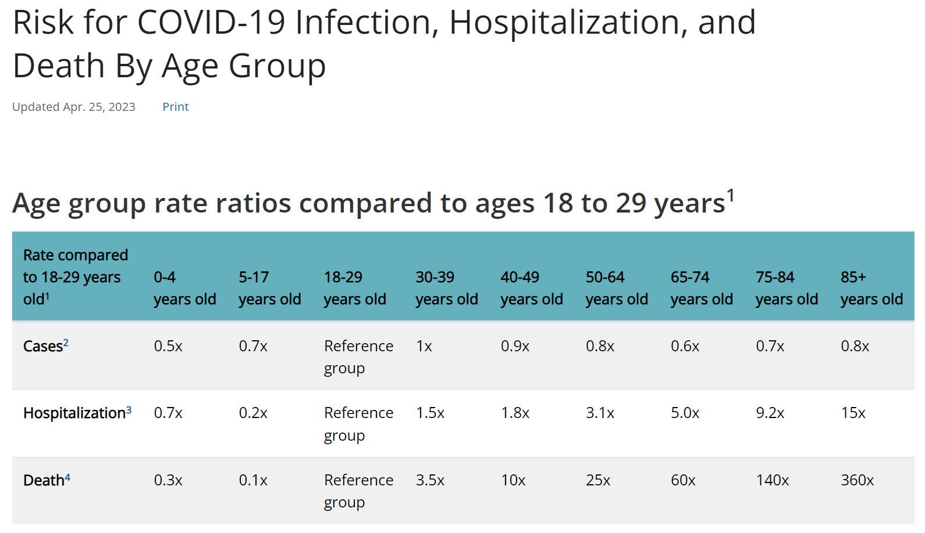
Why I may sometimes wear a mask
https://www.cdc.gov/coronavirus/2019-ncov/covid-data/investigations-discovery/hospitalization-death-by-age.html#print

